Slide 1

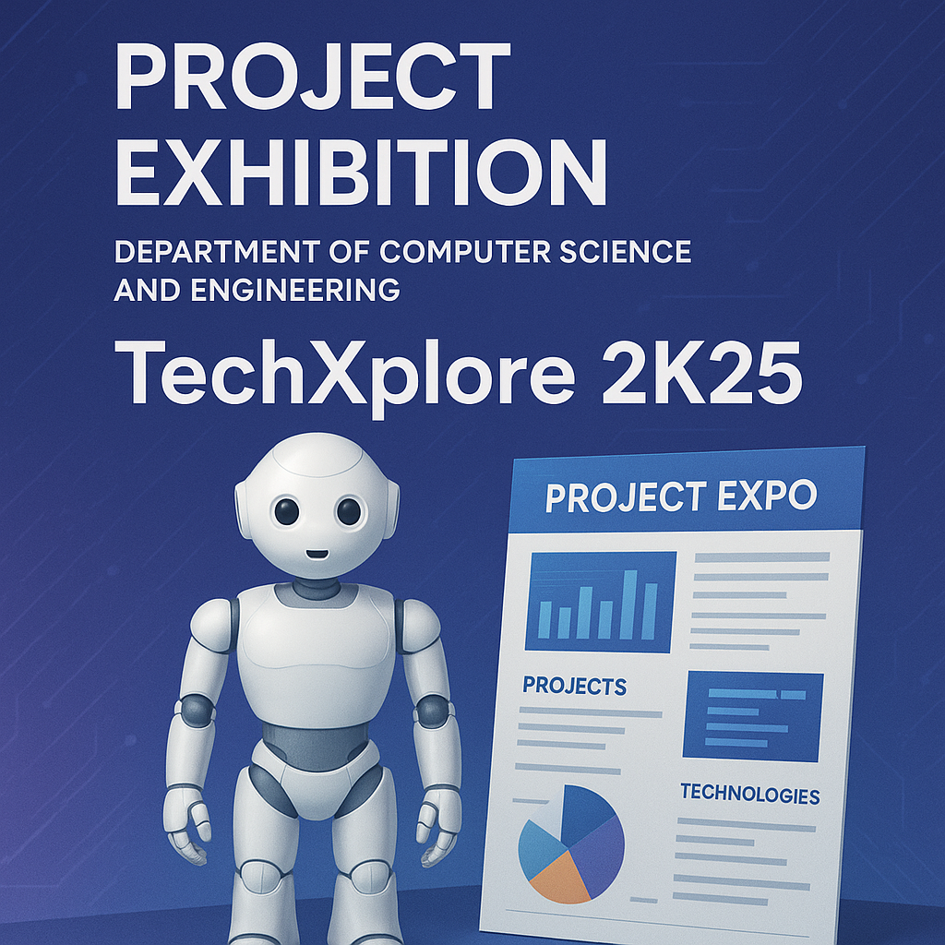
PREVENTION OF CYBER ATTACKS IN NETWORK INTRUSION DETECTION SYSTEM (NIDS) USING MACHINE LEARNING MODELS
Domain: Cybersecurity & Machine Learning
Team Members:
1. CHELLA KRISHNAN D

Slide 2

Problem Statement
Growth of IoT → exponential increase in cyber threats
Traditional security (firewalls, IDS, isolation) fails to scale for IoT
Absence of standardized IoT datasets for IDS evaluation
IoT traffic is complex, heterogeneous, and imbalanced
Challenge:Need for scalable, intelligent intrusion detection

Slide 3
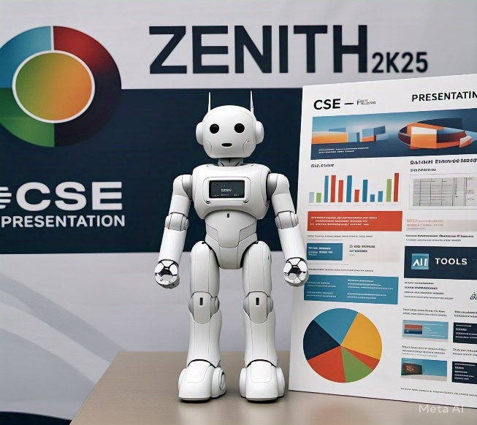
Proposed Solution
Build ML-driven Network Intrusion Detection System (NIDS) using ToN-IoT dataset
Apply feature selection (Extra-Trees Classifier) to remove redundancy & highlight critical features
Train & test multiple ML models:
Random Forest (RF)
- Decision Tree (DT)
- Support Vector Machine (SVM)
- K-Nearest Neighbors (KNN)
- Naïve Bayes (NB)
Evaluate on Accuracy, Precision, Recall, F1-score & Efficiency

Slide 4
Technology Used
ToN-IoT (Telemetry, OS logs, Network traffic)
Programming – Python (Anaconda, Jupyter Notebook)
Frameworks – Scikit-learn, Pandas, NumPy
Hardware– Standard computing environment

Slide 5
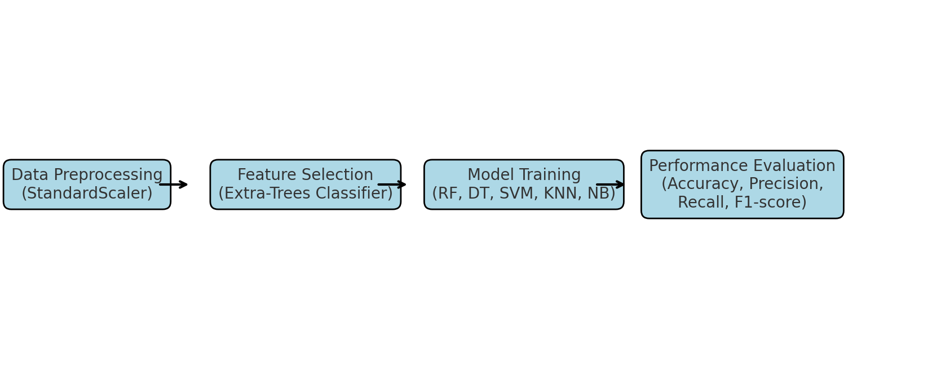
Methodology & Process
Workflow:
1. Data Preprocessing → Normalization with StandardScaler
2. Feature Selection → Extra-Trees Classifier for optimal features
3. Model Training → RF, DT, SVM, KNN, NB
4. Performance Evaluation → Accuracy, Precision, Recall, F1-score

Slide 6
Impact on Society
Stronger IoT Security – Prevents advanced cyber-attacks in IoT/IIoT
Healthcare & Industry– Protects sensitive IoT/IoMT networks
Innovation Boost – Safer environment for adopting emerging technologies
Economic Benefits – Reduces risk of data breaches & financial losses
Future Ready– Moves toward scalable, AI-powered cybersecurity

Slide 7
Conclusion & References
Key Findings:
Random Forest achieved 90% accuracy with minimal computation
Tree-based methods outperform other ML models
Naïve Bayes underperformed due to data imbalance
Limitation: Dataset imbalance affects detection accuracy
Future Work: Deep learning & advanced balancing strategies

